Slide 1
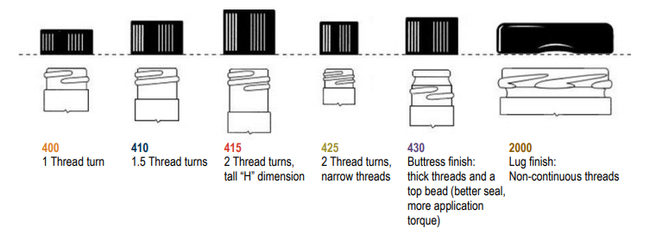
Common Neck Finishes

